Slide 1
Gini vs Entropy
entropy is more complex since it makes use of logarithms and consequently, the calculation of the Gini Index will be faster.
Accuracy using the entropy criterion are slightly better (not always).
P(C1) = 1/6 P(C2) = 5/6
Gini = 1 – (1/6)² – (5/6)² = 0.278
P(C1) = 2/6 P(C2) = 4/6
Gini = 1 – (2/6)² – (4/6)² = 0.444

Slide 2

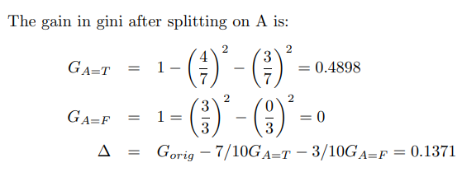
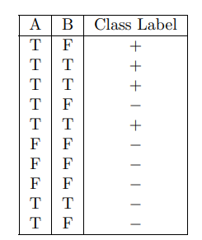
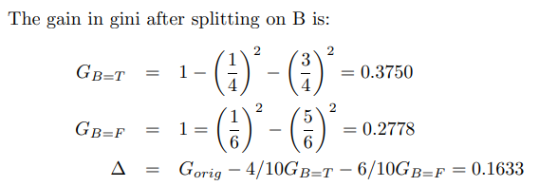
Example: Construct Decision tree using CART
attribute A will be chosen to split the node as Gini(A)<Gini(B)

Slide 3
Decision tree using CART algorithm
Day
Outlook
Temp.
Humidity
Wind
Play Tennis
D1
Sunny
Hot
High
Weak
No
D2
Sunny
Hot
High
Strong
No
D3
Overcast
Hot
High
Weak
Yes
D4
Rain
Mild
High
Weak
Yes
D5
Rain
Cool
Normal
Weak
Yes
D6
Rain
Cool
Normal
Strong
No
D7
Overcast
Cool
Normal
Weak
Yes
D8
Sunny
Mild
High
Weak
No
D9
Sunny
Cool
Normal
Weak
Yes
D10
Rain
Mild
Normal
Strong
Yes
D11
Sunny
Mild
Normal
Strong
Yes
D12
Overcast
Mild
High
Strong
Yes
D13
Overcast
Hot
Normal
Weak
Yes
D14
Rain
Mild
High
Strong
No

Slide 4
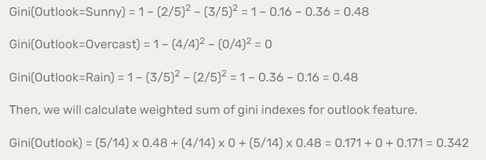
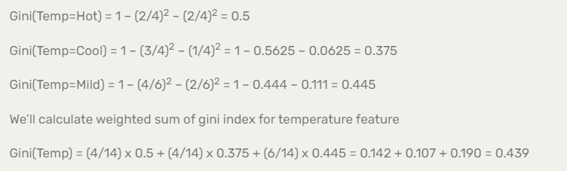
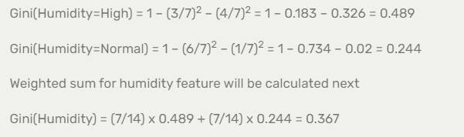
Selecting the Best Attribute for splitting using Gini
S=[9+,5-]
Outlook
Over
cast
Sunny
Rain
[2+, 3-]
[4+, 0]
[3+, 2-]

Slide 5
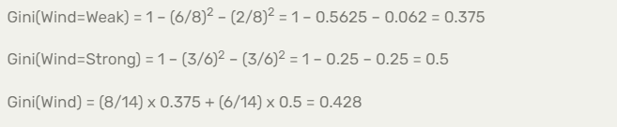
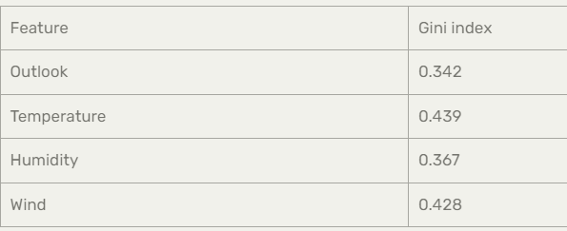
Outlook will be placed at root as it has high information gain (low Gini index).

Slide 6
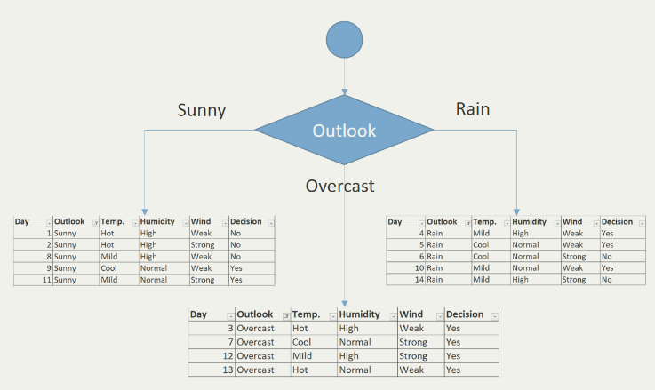

Slide 7
Regression trees
Regression trees are trees where their leaves predict a real number and not a class.
Example CART
CART stands for Classification and Regression Trees. An important feature of CART is its ability to generate regression trees
CART looks for splits that minimize the prediction squared error (the least–squared deviation). The prediction in each leaf is based on the weighted mean for node.

Slide 8
Algorithm
Step 1: The standard deviation of the target is calculated.
Step 2: The dataset is then split on the different attributes. The standard deviation for each branch is calculated. The resulting standard deviation is subtracted from the standard deviation before the split. The result is the standard deviation reduction.
Step 3:The attribute with the largest standard deviation reduction is chosen for the decision node.
Step 4a: The dataset is divided based on the values of the selected attribute. This process is run recursively on the non-leaf branches, until all data is processed.
Repeat all the steps until when coefficient of deviation (CV) for a branch becomes smaller than a certain threshold (e.g., 10%) and/or when too few instances in a branch

Slide 9
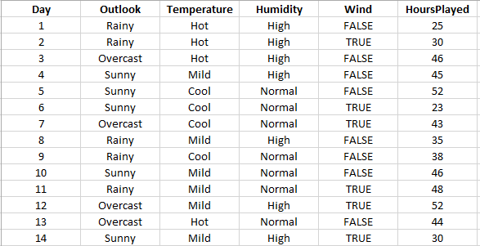
CART Example
Hours played is target (continuous outcome) -- regression

Slide 10
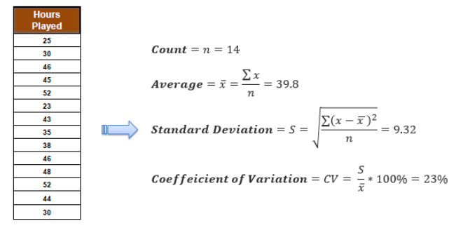
a) Standard deviation for target:

Slide 11
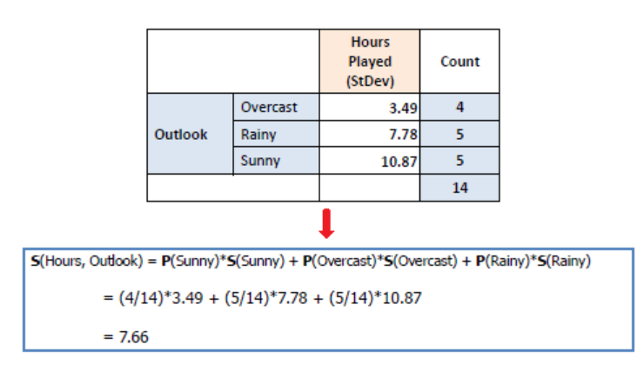
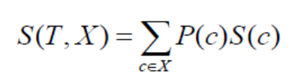
Compute SD for outlook
Rainy : 25, 30, 35, 38, 48
Mean = 35.2
Std. Dev = [(25-35.2)^2 + (30-35.2)^2 + (38-35.2)^2 + (48-35.2)^2 ]/ 5
= 7.78
The standard deviation reduction = Std. dev (Hours)- Std. dev (Hours, outlook))
= 9.32- 7.66 = 1.66

Slide 12
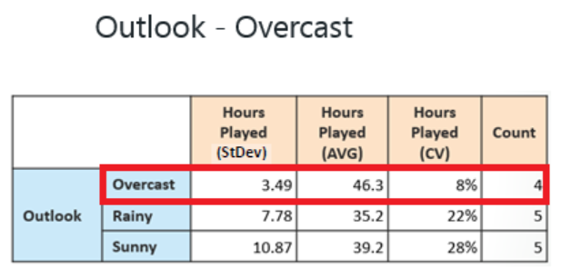
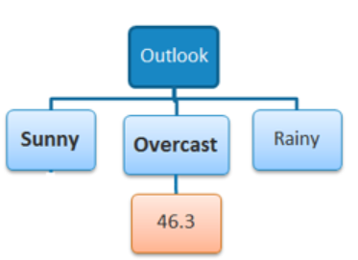
In practice, we need some termination criteria. For example, when coefficient of deviation (CV) for a branch becomes smaller than a certain threshold (e.g., 10%) and/or when too few instances (n) remain in the branch (e.g., 3).
3.49 / 46.3 = 7.53% = 8%
(46+43+52+44)/4 = 46.25 = 46.3
"Overcast" subset does not need any further splitting because its CV (8%) is less than the threshold (10%). The related leaf node gets the average of the "Overcast" subset.

Slide 13
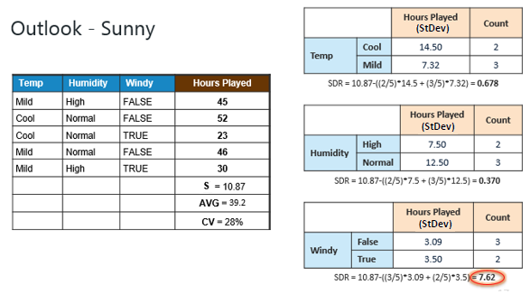
The "Sunny" branch has an CV (28%) more than the threshold (10%) which needs further splitting. We select "Temp" as the best best node after "Outlook" because it has the largest SDR.

Slide 14
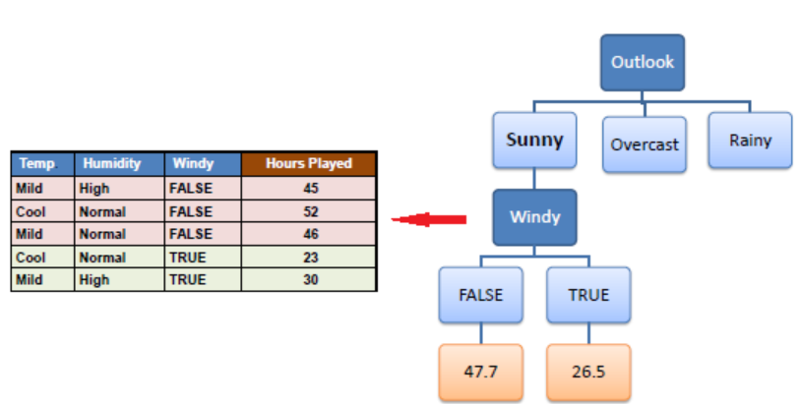
Because the number of data points for both branches (FALSE and TRUE) is equal or less than 3, we stop further branching and assign the average of each branch to the related leaf node.

Slide 15
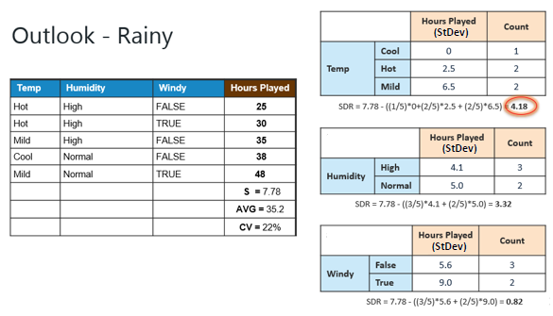
Moreover, the “Rainy" branch has an CV (22%) which is more than the threshold (10%). This branch needs further splitting. We select "Temp" as the best best node because it has the largest SDR.

Slide 16
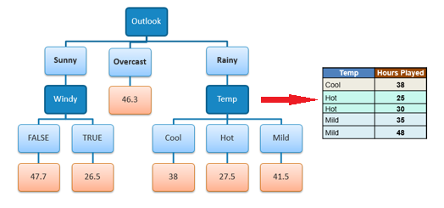
Because the number of data points for all three branches (Cool, Hot and Mild) is equal or less than 3 we stop further branching and assign the average of each branch to the related leaf node.

